Slide 1
Newton’s Third Law and the IO-Lab
An application of a device developed at UIUC may help further student understanding of concepts presented in introductory physics.

Slide 2
Thank You
Mats Salen
  University of Illinois PER research group
Tim Stelzer
  University of Illinois PER research group
Katie Ansell
Eric Martell

Slide 3
Thank You
Further Resources and history can be found at
http://www.iolab.science/
https://www.youtube.com/channel/UCkgql1ePbwyCP-selmAUJng/playlists?view=1&flow=list&view_as=subscriber&sort=da

Slide 4
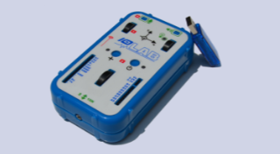
IO-Lab device.

Slide 5
Software and Hardware
Open Source and Free
Open up the device and play.

Slide 6
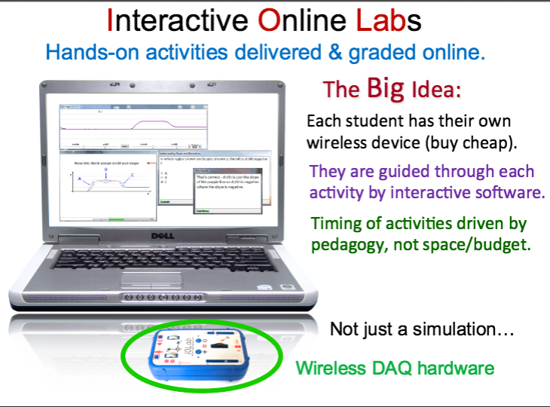
The Vision

Slide 7
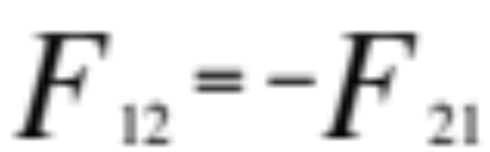
Newton’s Third Law
All forces come in pairs that act on different parts of the system
Many students have difficulties visualizing and understanding how this will apply to solving problems.

Slide 8
Objectives
Hands on Activity
Help students gain an understanding of action reaction forces.
Help Students make connections between Physical, Graphical and Mathematical representations of a system.

Slide 9
Pre Lab
Questions from FCI
The Lab

Slide 10
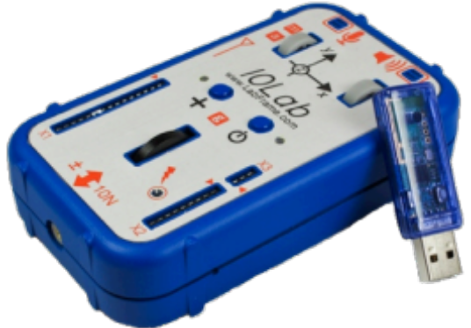
Welcome to IOLab
You are about to play around
with a gadget that will help you
explore force and acceleration.

Slide 11
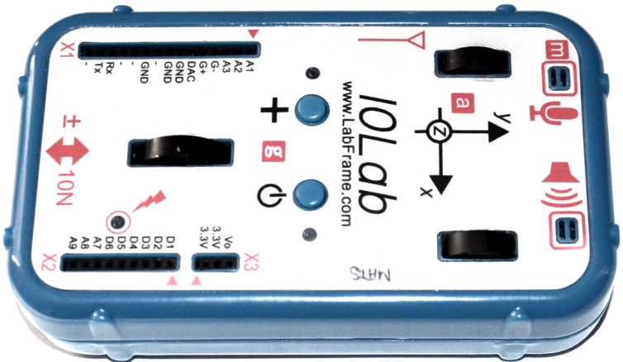
Introduction
The IOLab gadget can measure force and acceleration using a built-in wheel and the retractable place in front where there is a screw inserted.
Measuring wheel
Retractable screw will be inserted

Slide 12
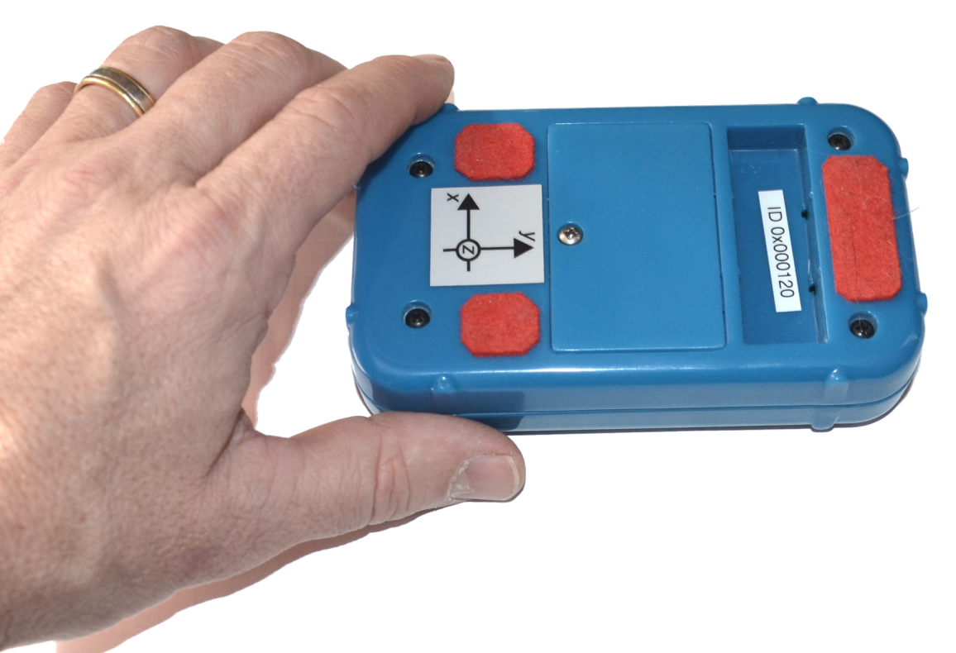
Introduction
The IOLab gadget can measure force and acceleration using a built-in wheel and retractable screw.
Flip the IOLab gadget over so you can roll it back and forth.

Slide 13
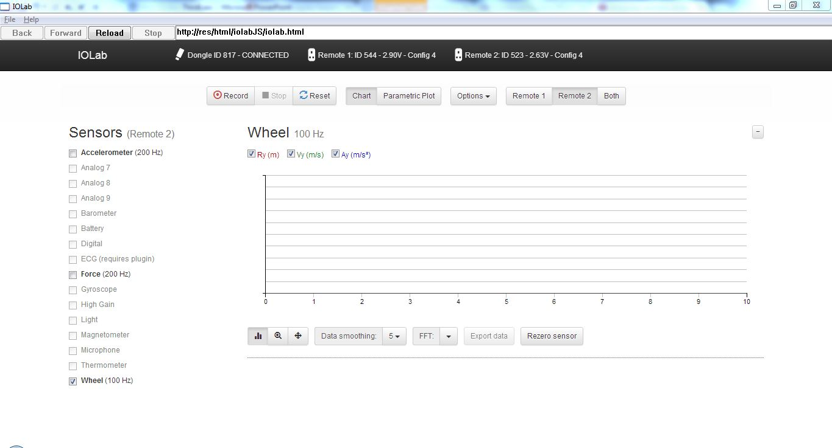
The System
Your IOLab system should be ready to go, with the screen looking like this:
Click on the Record button to start data acquisition, and click on the Stop button to stop.
Go ahead and move the device to watch the wheel record position, velocity, and acceleration.

Slide 14

The System
Click the boxes to uncheck Ry and Ay, so that you can focus on velocity. Move the IOLab back and forth, and watch the patterns. Go ahead and move the device quickly, and slowly, and however you want. ☺
In particular, see if you can get it to move at a (roughly) constant velocity. Observe the patterns. Do the same for an increasing velocity (what should the v vs. t graph look like in this case?).

Slide 15
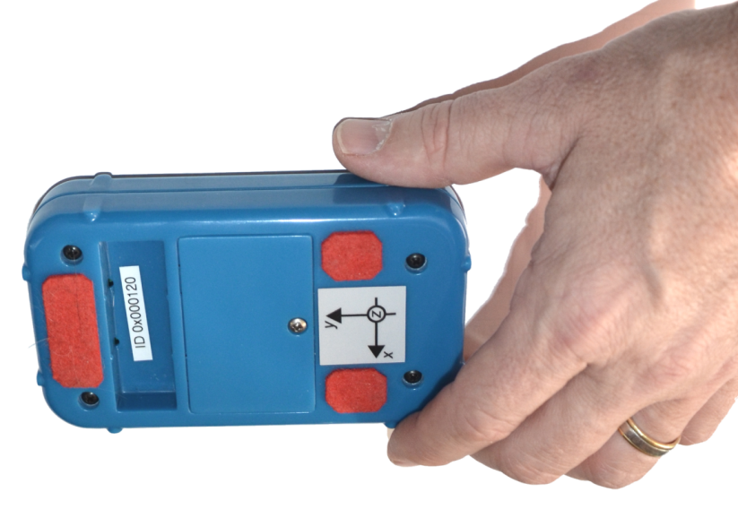
The System
Now, click Reset and Both at the top of the screen. Select the Force sensor for each. Click record, and bounce the IOLabs off each other. Make sure you can see F vs. t graphs for both IOLabs.

Slide 16
The Activities
Now that you know how the IOLab system works, you will use it to explore how forces act upon objects in different scenarios..

Slide 17
Scenario 3
For the next scenario, place both devices on the table and remove the extra mass so that each device has equal mass.
Begin with one device sitting at rest.
You will push the other device (retractable screw against retractable screw) against the resting device, and do your best to keep the speed constant.
Practice using the wheel sensors as before if necessary.
View the Force vs. time graphs.
Think about….
  Do the forces look the same (shapes, size, etc)?
  Is one force greater or less than the other?

Slide 18
Scenario 4
For the last scenario, repeat the steps from scenario 3, EXCEPT this time you will push the devices at an increasing speed.
Think about….
  Do the forces look the same (shapes, size, etc)?
  Is one force greater or less than the other?

Slide 19
Congratulations!
You have now completed the experiment.
Please raise your hand once you are finished and take the next few minutes to complete the questions on the post-test.
Thank you!

Slide 20
Other Activities
Friction
Newton’s second Law (under development)
Simple Harmonic Motion. (Under development)
RC-Circuit.
Faraday’s law (Under Development).
Labs in White will be in place by 2016.

Slide 21
Questions?

